Slide 1
Freelance Forge

Slide 2
List of Entities
Entity Name | Primary Attributes
Users | User_id, username, email, password, img, country, phone, desc, isSeller, createdAt, updatedAt
Gigs | Gig_id, userId, title, desc, totalStars, starNumber, cat, price, cover, shortTitle, shortDesc, deliveryTime, revisionNumber, sales, createdAt, updatedAt
Orders | Order_id, gig_Id, img, title, price, sellerId, buyerId, isCompleted, payment_intent, createdAt, updatedAt
Reviews | Review_id, gig_Id, user_Id, star, desc, createdAt, updatedAt
Conversations | Convo_id, seller_Id, buye_rId, readBySeller, readByBuyer, lastMessage, createdAt, updatedAt
Messages | Message_id, conversation_Id, user_Id, desc, createdAt, updatedAt
Subscription | Subscription_Id, userId, tierId, startDate
SubscriptionTier | Tier_Id, name, price, features
Payment | paymentId, userId, amount, paymentDate
Star Rating | value, label
Country List | name, code
Category | Cat_id, name, description

Slide 3
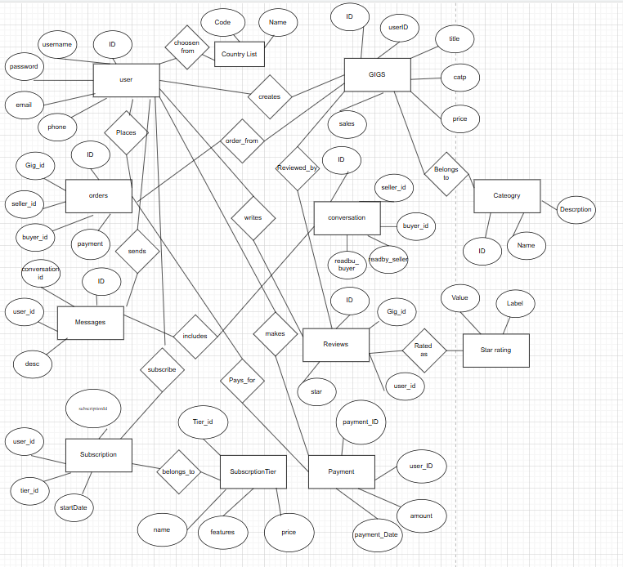
Conceptual ER Diagram
Gig_
User_id
Order_
Convo_
Cat_
Messa__
Revi_

Slide 4
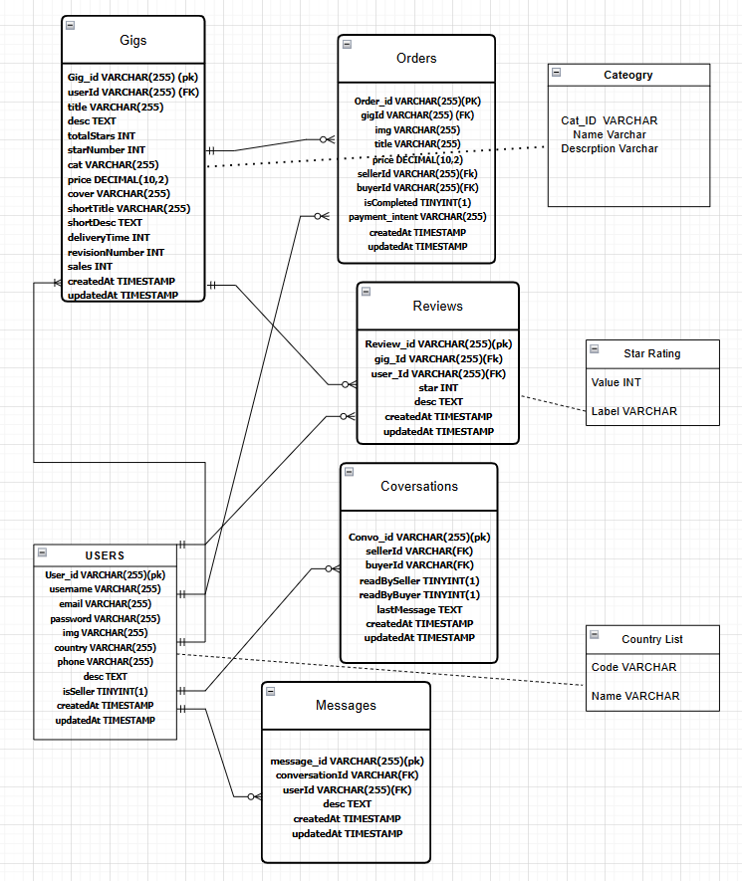
Logical ER Diagram

